Slide 1


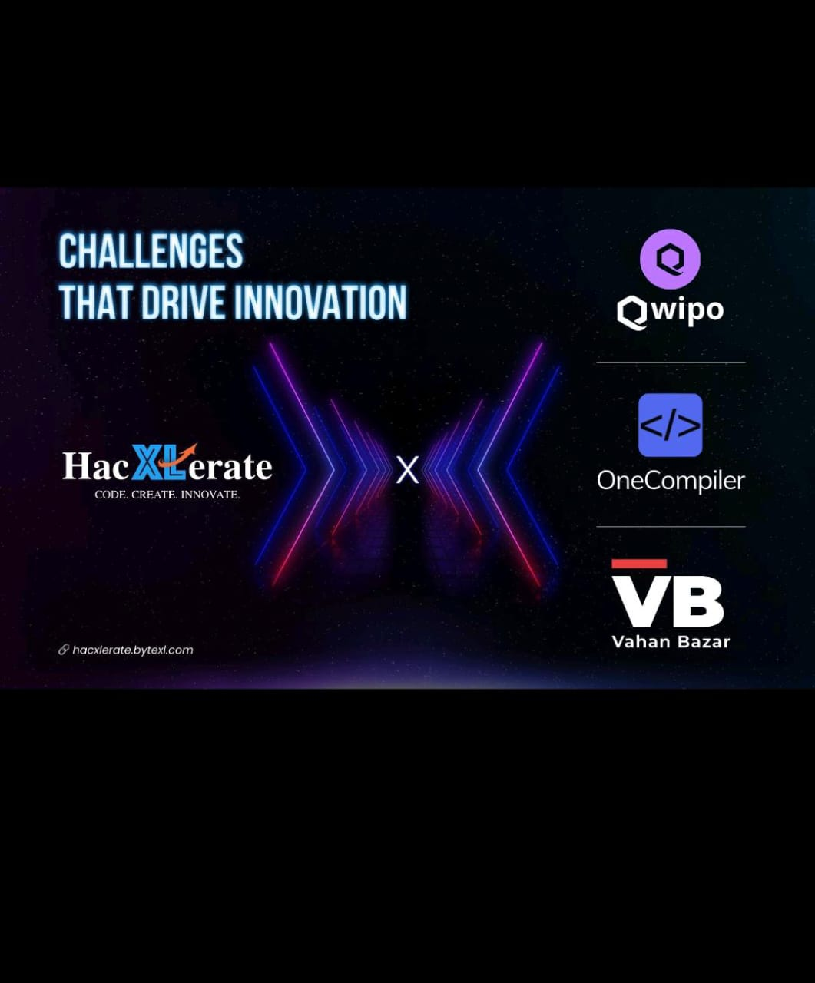
NIMBUS NAVIGATORS :
M.Govardhini
K.Monika Satya Durga
K.Bhuvaneswari
K.Naga Swetha
K.Ramya Rani

Slide 2
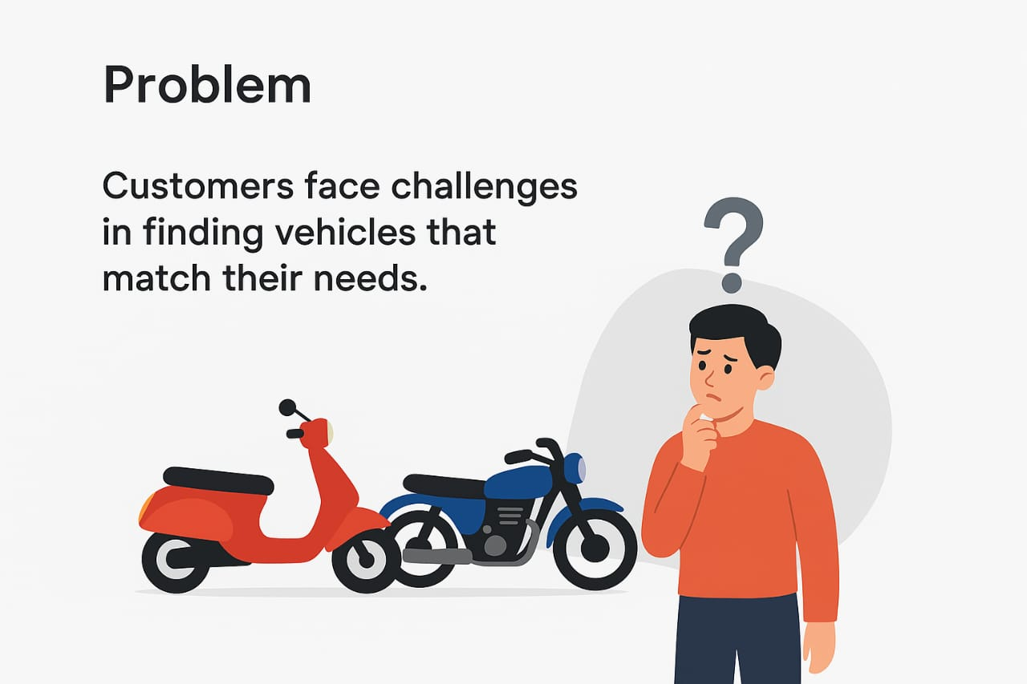
Problem Statement : Vahan Bazar
Build a two-wheeler marketplace web app where users can browse bikes, scooters, and EVs, search and filter by brand, price, or fuel type, view detailed specs with images, compare model's side by side, use EMI and fuel cost calculators, check upcoming launches, explore showrooms, and book test rides or sell used bikes.

Slide 3

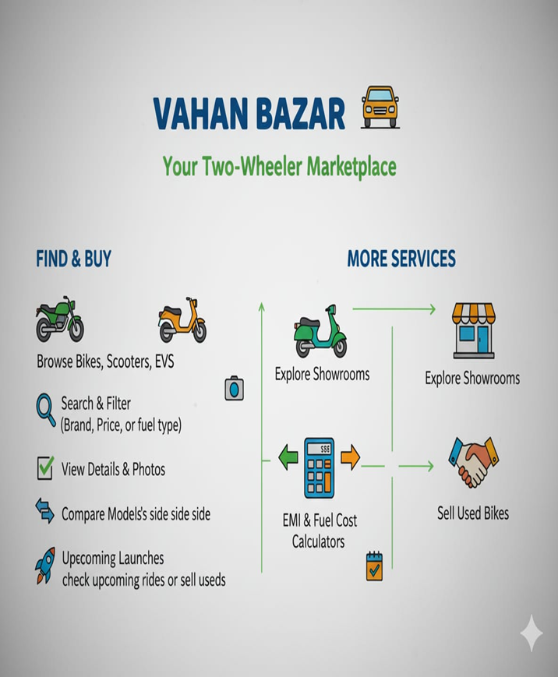
Proposed Solution:
One-stop marketplace for two-wheelers:
New bikes, scooters, EVs
Certified second-hand vehicles
Smart features for buyers:
Unified filtering by brand, price, fuel type & model
Side-by-side vehicle comparison for quick decisions
Instant one-click test-ride booking with nearby dealers
Support for sellers & dealers:
Easy listing process with vehicle details
Automated “second-hand score” for credibility
Direct lead generation through scheduled test rides
End-to-end user journey:
Browse → Filter → Compare → Book test ride → Connect with dealer

Slide 4
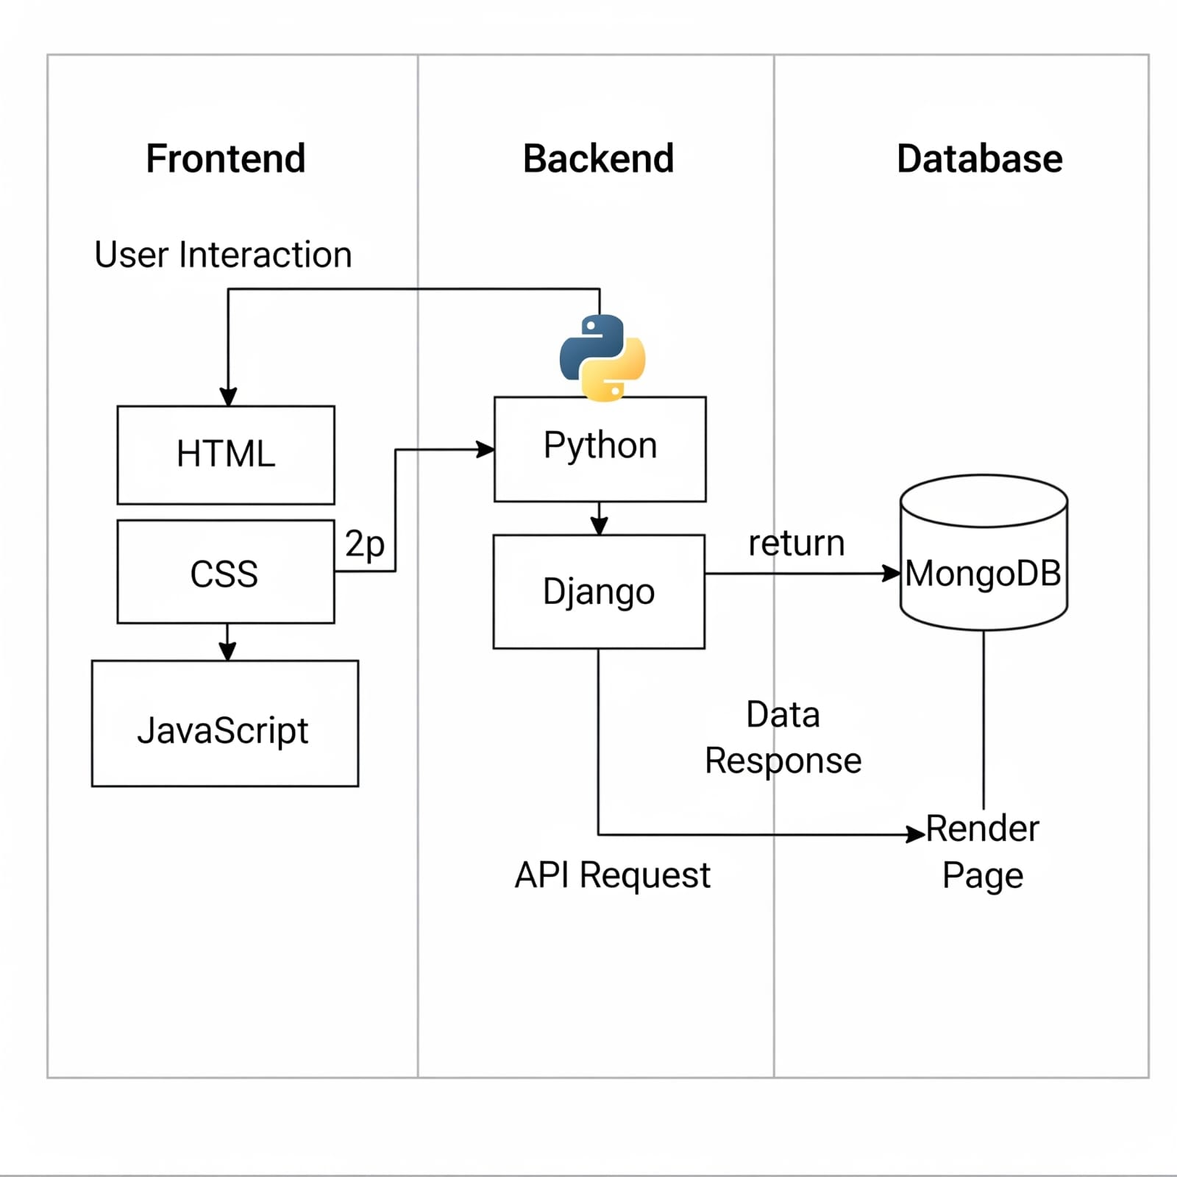
Technologies:
Frontend:
HTML
CSS
Java Script
Backend:
Python
Django
Data Base:
MongoDb

Slide 5
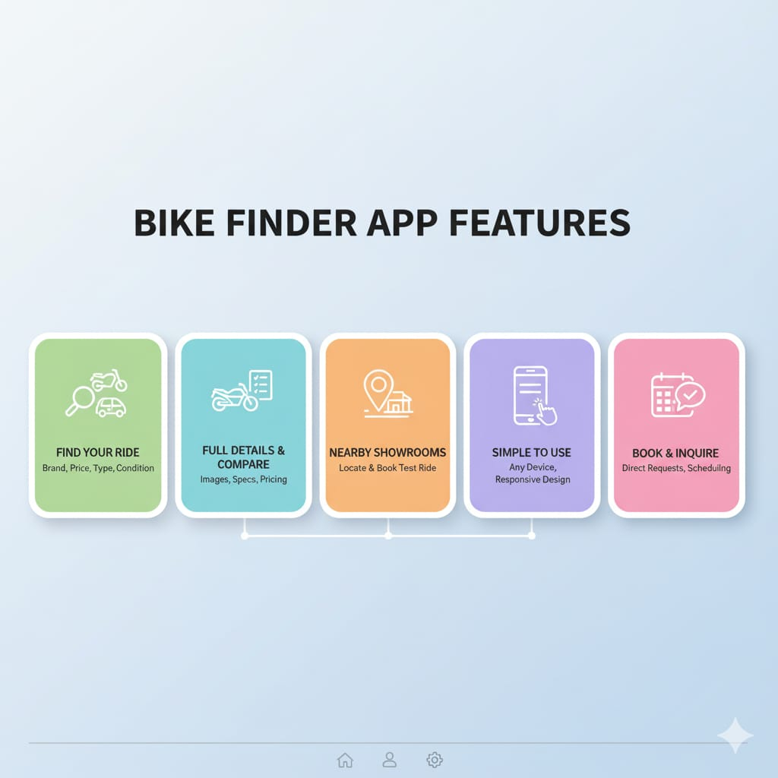
Features:
Smart Vehicle Search & Filters – Browse bikes, scooters, and EVs with filters by brand, price, fuel type, and condition (new/second-hand).
Detailed Vehicle Listings – Each listing includes images, specifications, pricing, and comparison options.
Showroom & Dealer Integration – Explore authorized showrooms, locate nearby dealers, and book test rides.
User-Friendly Interface – Simple, responsive design for easy navigation across devices.
Booking & Contact Options – Direct booking requests, inquiries, and test ride scheduling.

Slide 6
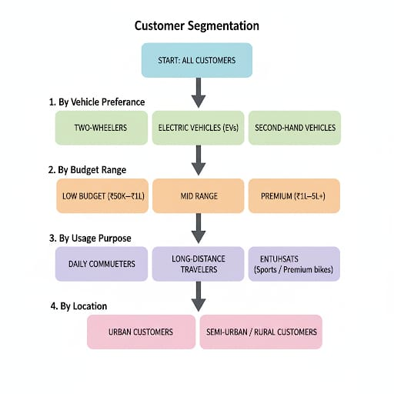
Customer Segmentation:

Slide 7
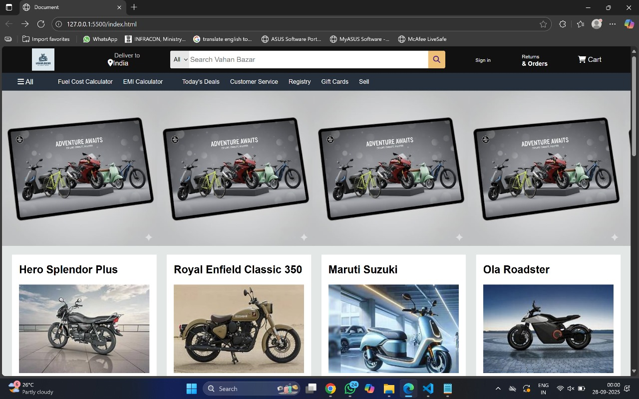
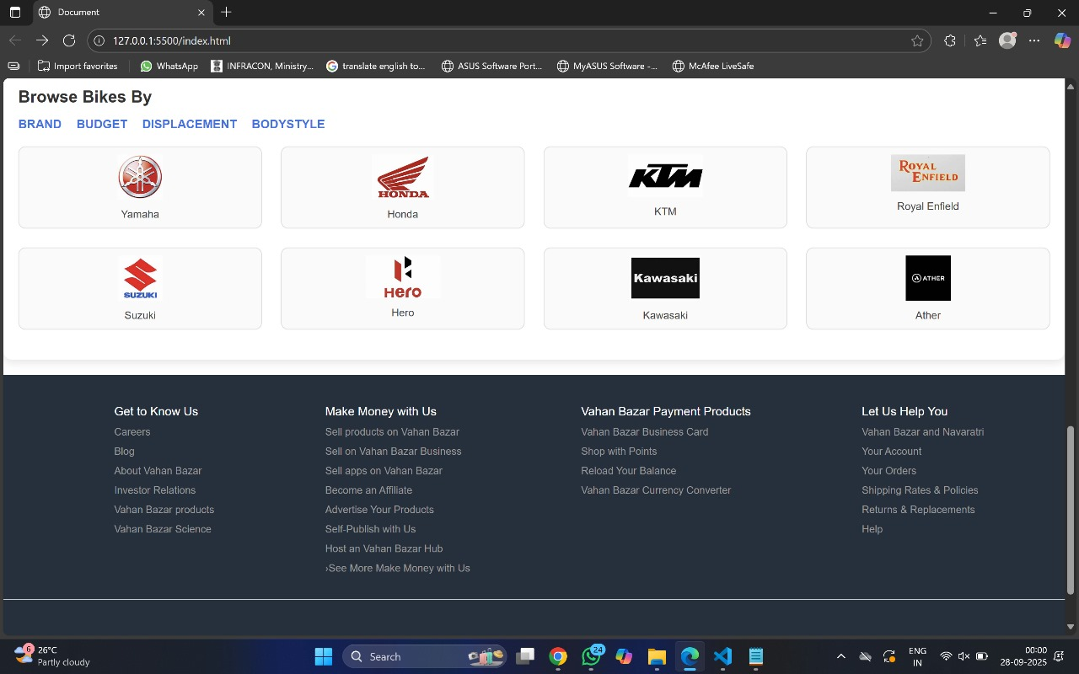
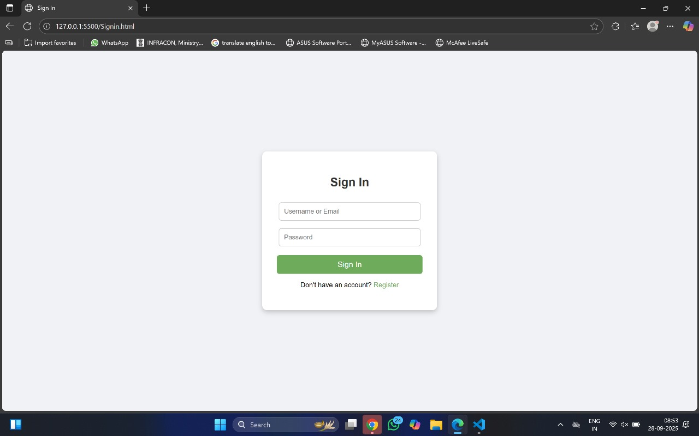
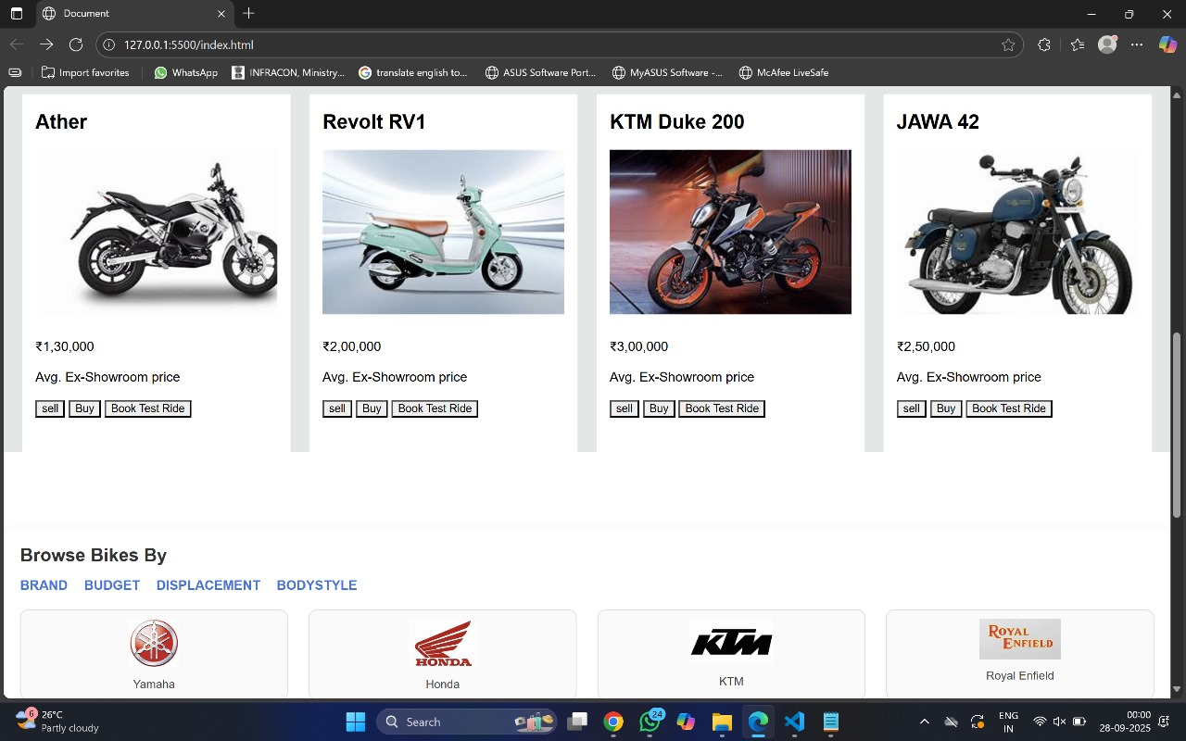
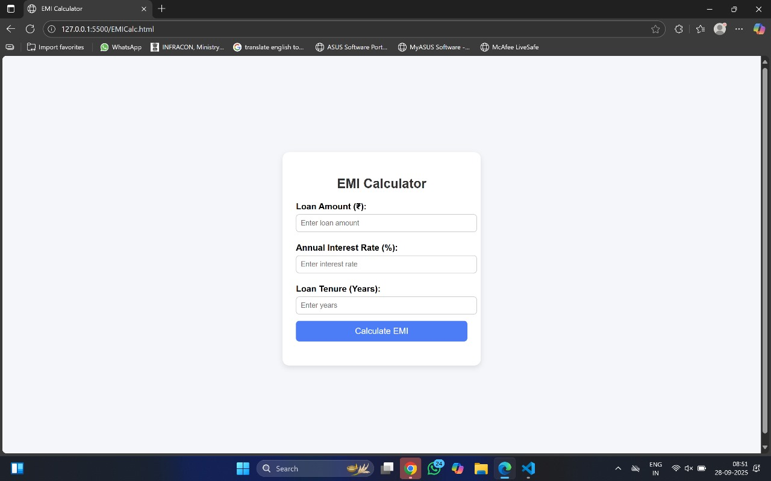
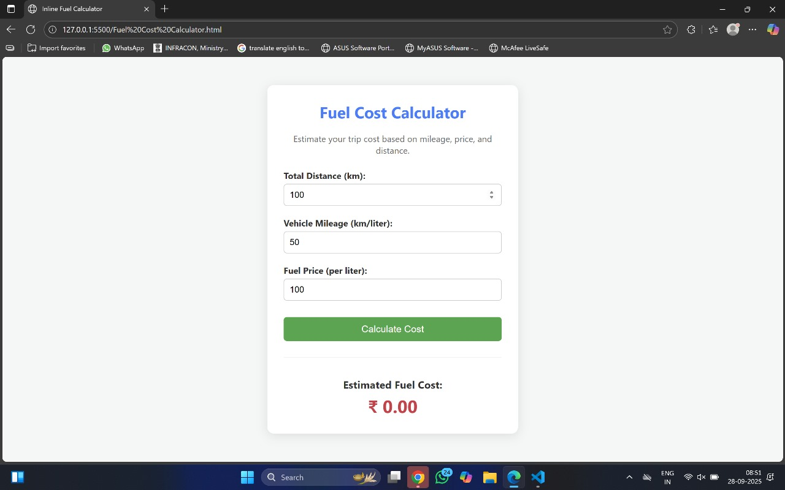
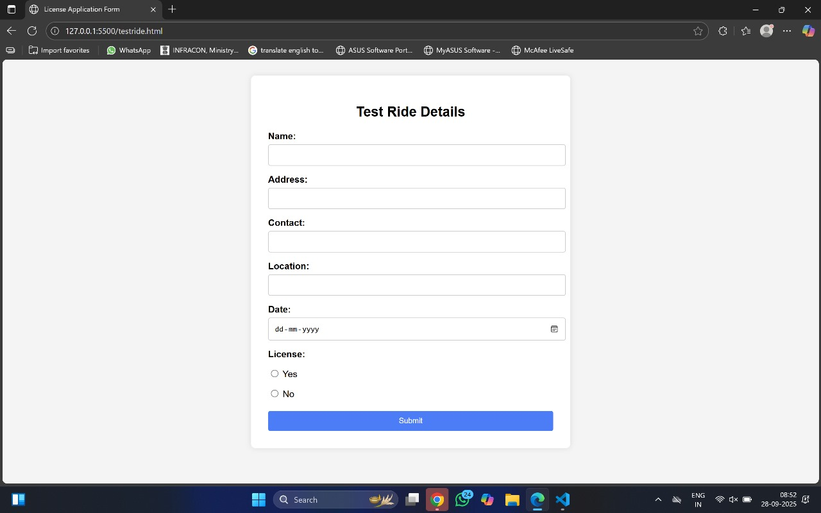
Conclusion:
One-stop platform for exploring, comparing, and purchasing two-wheelers (new, EVs, and second-hand).
Seamless user experience with smart filters, detailed listings, and showroom integration.
Bridges customers and dealers by enhancing convenience, transparency, and trust.
GITHUB: https://github.com/Govardhani-9696/VAHAN-BAZAR

